Slide 1
Engineering Education Jesse Zhu, Western University Canadian Academy of Engineering
A CAETS Discussion Group
Report to CAETS Council, @ Stockholm, June 27, 2019

Slide 2
Engineering Education, the Working Group
The working group met 3:13-5:15, June 24, 2019
15~20 people attended the meeting, representing a large number of countries: Britain, Australia, Japan, New Zealand, Korean, Hungary, Nigeria, South Africa, Netherlands, Canada, - list to be completed.
Various issues were discussed.
A tentative action plan was formed.

Slide 3
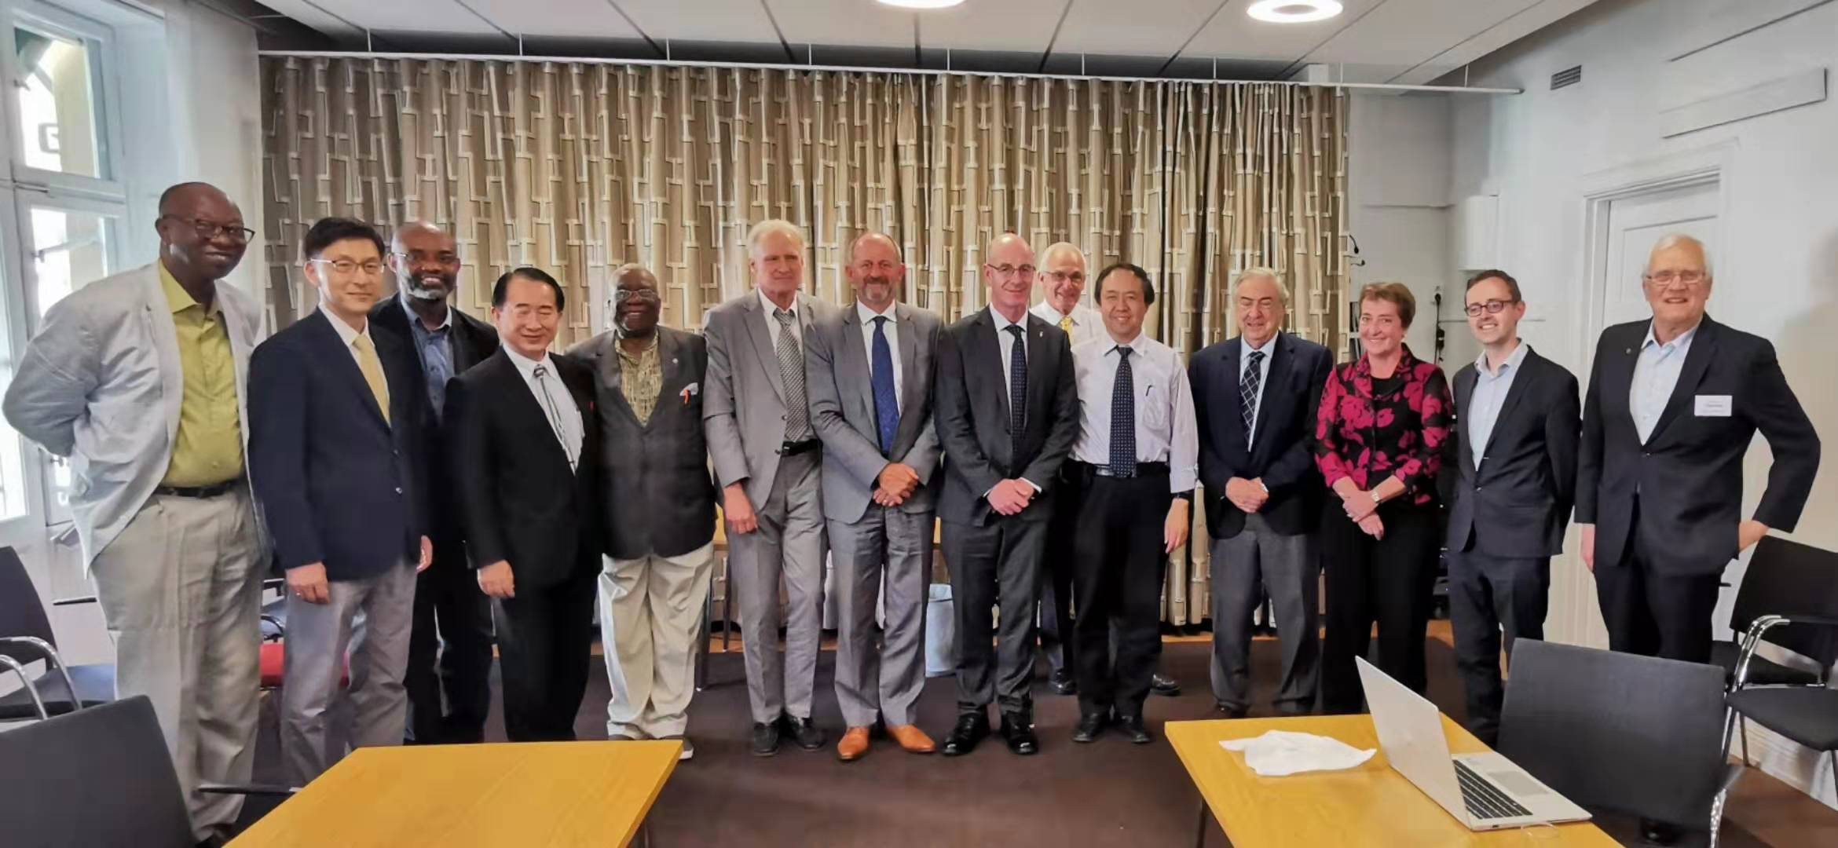
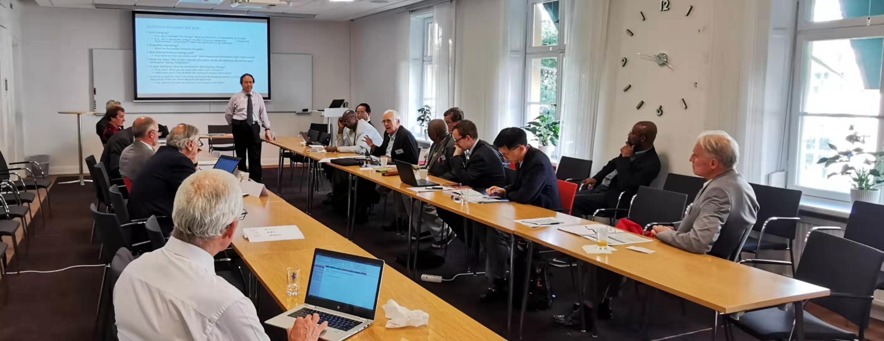

Slide 4
Issues raised and discussed
Dynamic changes in Engineering education
The diversified needs
The impact of technology
Customized / personalized learning (virtual experimentation, etc)
Lifelong learning – how does it fit into engineering education?
What to expect in 25 years ? 50 years? 100 Years?
Preparedness at all levels
Leadership not only to cope, but to lead

Slide 5
Observations
Some academies are deeply involved in Engineering Education while others are not.
EngEdu may be broadly defined (such as from a pipeline perspective) or narrowly focused on the university-level programs.
Would the demand side (employer perspective) be driving the changes over the coming decades?
Things may vary large by country (or groups of countries).
STEM education may have a silent “E”?
Where is the next break-through?
There is a need for continued Discussion

Slide 6
As CAETS, what we can do (about EngEdu)
“Sharing experiences/best practices among CAETS members”, how to benefit our members.
Increasing the public awareness toward Engineering Education – still major building blocks for the economy.
Making statement to voice CATES’ opinion and to promote Engineering Education – but how and to what details?
Encouraging international education, exchanges and collaborations
Articulating a set of desired outcomes (distinct from those used for accreditation) for various stages in an “educating engineers” pipeline, e.g., offering a self-assessment tool that could be used by institutions to evaluate their programs.
(We should not try to do what the International Engineering Alliance has done in terms of driving accreditation standards.)

Slide 7
A Tentative Action Plan
Establish an effective communication channel for further discussion
Forming a small working group to re-iterate and then converge ideas
To prepare a document for discussion within the group
Possibly, to bring such a good working document into the Seoul Meeting next year, when we shall seek broader consultation, and hopefully to form a CAETS statement for Engineering Education

