Slide 1

THIS IS ENGINEERING INTRO
CAETS Comms Working Group
October 2020

Slide 2
1.0
CHALLENGE

Slide 3

1.1
OUR CHALLENGE
>20% UK Gross Value Added
50% exports
Critical to addressing global challenges
Annual shortage of 59,000 engineers
12% female
< 8% BAME
This is Engineering / CAETS

Slide 4
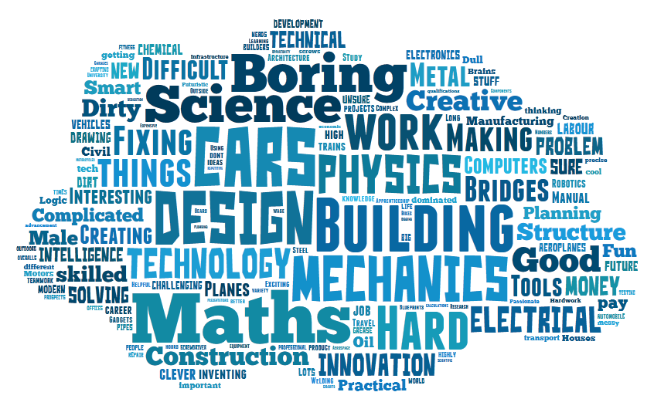
1.2
NARROW, OUTDATED PERCEPTIONS
This is Engineering / CAETS

Slide 5

1.3
EMBEDDED IN PUBLIC DISCOURSE
This is Engineering / CAETS

Slide 6
1.4
OUR OBJECTIVE
TO TRANSFORM PERCEPTIONS OF ENGINEERING AND INSPIRE YOUNG PEOPLE TO BECOME THE NEXT GENERATION OF ENGINEERS.
This is Engineering / CAETS

Slide 7
1.5
OUR INSIGHT IN SUMMARY
Perceptions were that engineering is narrow, mechanical, out of reach and uncool
Young people identify early as either STEM or non-STEM inclined, but engineering inhabits a middle ground
Young people need to see ‘people like me’ to imagine engineering as their future
What appeals can be found in engineering: Gen Z and Y want to bring ideas to life, shape the future, help others, make a difference
This is Engineering / CAETS

Slide 8
1.6
THE ROLE FOR OUR CAMPAIGN
USE ENGINEERING’S BREADTH AND VARIETY AS ITS STRENGTH.
This is Engineering / CAETS

Slide 9
1.7
KEY PRINCIPLES
Connect with teens directly through media they consume and trust
Talk to them about what they’re already interested in
^{Show them people like them}
Capitalise on times when they're thinking about their futures
This is Engineering / CAETS

Slide 10
2.0
OUR RESPONSE

Slide 11








2.1
SHOW THEM PEOPLE LIKE THEM
This is Engineering / CAETS

Slide 12
2.2
KEY MESSAGES
The following key messages underpin This is Engineering and have been informed by audience research and testing.
Engineers bring ideas to life, shape the future, and make a difference. They work on some of the world’s biggest challenges.
Whatever you are interested in, you can pursue your passion through engineering.
Engineering careers are varied and creative.
Engineers come from a variety of backgrounds, and there are lots of different routes into engineering.
There has never been a better time to get involved in engineering.
This is Engineering / CAETS

Slide 13






2.3
CAREFUL TARGETING
Strong performance vs. all metrics
Audience affinity More testing required
Highest reach Improvement in VCR
Highest VCR
Low CPVs Targeting parents
Full video completion High CTR
This is Engineering / CAETS

Slide 14
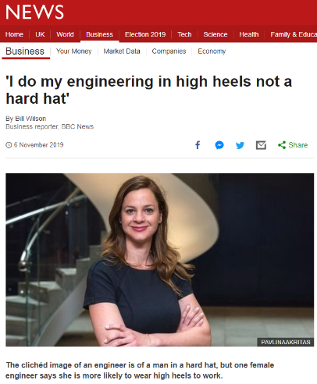
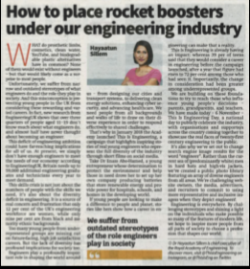
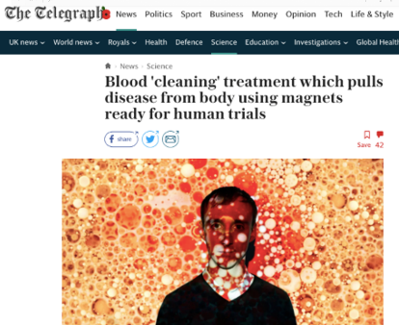
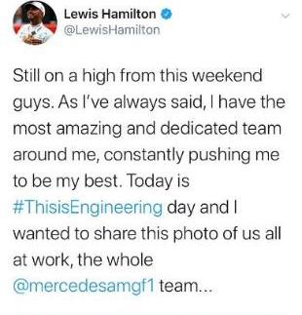
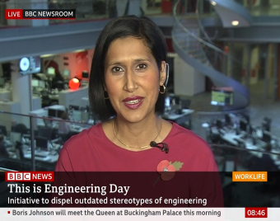
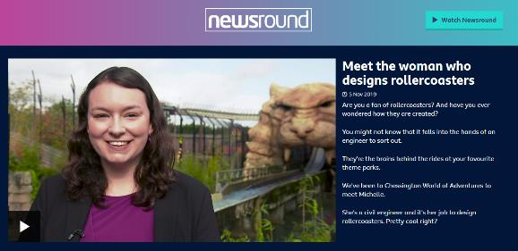
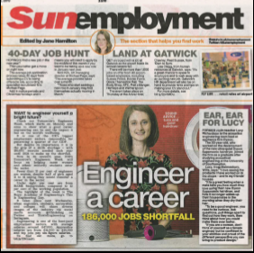
2.4
REPOSITIONING ENGINEERING FOR EVERYONE
This is Engineering / CAETS

Slide 15
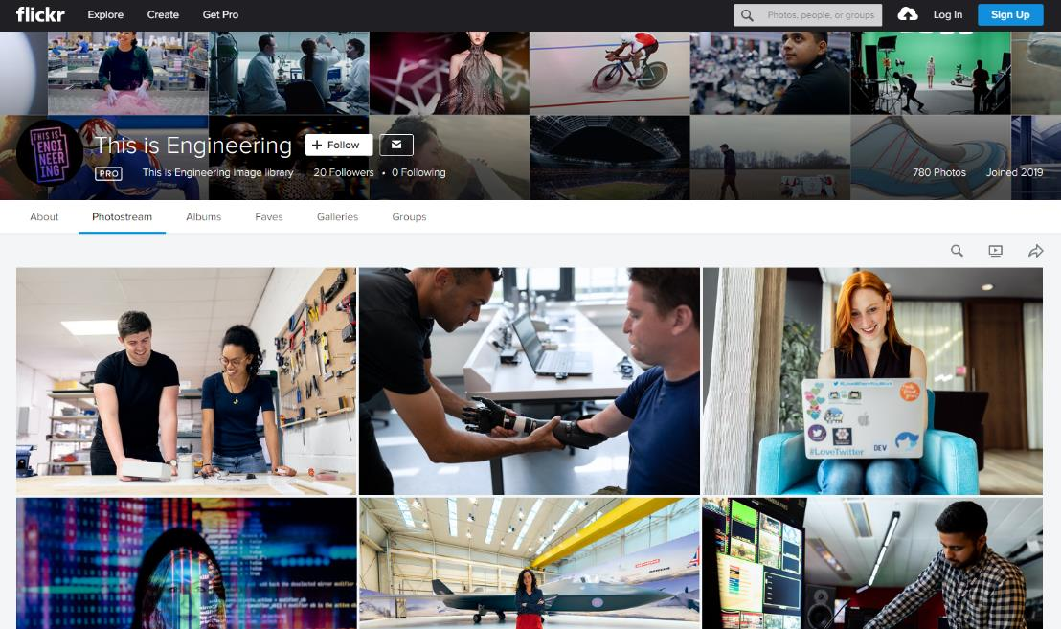

2.5
SHARING THE CHALLENGE TO SCALE IMPACT
To challenge narrow perceptions of the profession, we launched a new public library with more representative images of engineers.
780 photos donated by over 40 organisations
450,000⁺ audience reached to date
This is Engineering / CAETS

Slide 16
3.0
OUR IMPACT

Slide 17
3.1
WE’RE MAKING PROGRESS
45m+ views of campaign films, by a gender-balanced
audience of teens
1m+ other engagements on social media
85% increase in consideration of engineering as a career among teens*
71% teens who saw the campaign did something as a result*
118% for Black, Asian and minority ethnic teens
129% for female teens
This is Engineering / CAETS

Slide 18
3.2
STUDENTS ARE TAKING ACTION
Students were asked: “Have you taken any of the following actions as a result of seeing this ad campaign?”
This is Engineering / CAETS

Slide 19
3.3
POSITIVE RESPONSE FROM PARENTS
Did you do something as a result or seeing/hearing it?
This is Engineering / CAETS

Slide 20
3.4
THIS IS ENGINEERING DAY, 6 NOV 2019
Media Coverage
Social Media
Image
Activity
14 million people reached through media coverage:
43 print media
17 broadcasts
12 million people reached with #ThisisEngineering
150 pledge signatories
780 photos donated to our Flickr image library
450,000 views of images
This is Engineering / CAETS

Slide 21

Any questions?

