Slide 1
CAETS strategy beyond 2020
Proposal for discussion

Slide 2
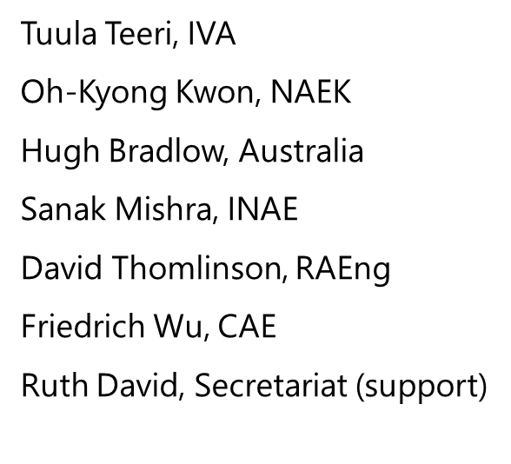
Strategic development of CAETS
At the CAETS Board meeting 24 June 2019, it was agreed that the Board would appoint a small group to develop a 5- year strategic plan organized around three components:
Structuring CAETS to more effectively execute its plan;
Membership Development; and
Achievement of CAETS Objectives.
The intent is to have this draft plan reviewed and commented by the Council July/August 2020 and the final plan presented for concurrence at CAETS annual meeting in the autumn 2020.

Slide 3
Objectives of CAETS - a proposal for a slight revision of the current CAETS Bylaws - Article 1.
Provide an independent nonpolitical and non-governmental international forum for enlightened dialogue and communication of engineering and technological sciences,
Contribute to advancing engineering and technological sciences in order to promote economic growth, sustainable development and social welfare throughout the world,
Foster collaboration and the development of bi- and multilateral programs between the member academies,
Prepare science-based proposals in order to advise governments and international organizations on policy issues related to engineering end technology development,
Promote diversity, inclusion and ethics in the global engineering profession,
Contribute to continuous improvement and modernization of engineering education and practice internationally,
Foster a balanced public understanding of the applications of engineering and technology,
Foster establishment of engineering academies in countries where none exist.

Slide 4
Structuring CAETS to more effectively achieve the goals – working groups
Being an informal network organization, CAETS has often experienced difficulties in leveraging the results of the various discussion groups/committees and agreeing on the CAETS statements following the annual convocations.
Proposal to consider:
Constitute Committees/Working Groups that are based on strong mutual interest to improve ownership, commitment, engagement and leverage.
These themes/activities may be of global significance or region-specific (like Asia, Europe, Africa etc.).
Assign a committed leadership for each working group for a duration of 3-5 years at a time.
Establish a mechanism for an annual board/council review of the work done by the Committees/Working Groups, including a plan how to communicate the results.
The recommendations emanating from such activities should be offered to concerned national/international bodies for facilitating engineering solutions and implementation AND/OR represent the themes for some of the the Annual Convocations.

Slide 5
Structuring CAETS to more effectively achieve the goals – board
Section 4. Terms: The terms of office for the officers of the Board, with the exception of the Secretary/Treasurer, shall be one year … The terms of office for the additional 8 members of the Board shall be two years.
Proposal to consider
Establish a ‘Standing Committee for CAETS Strategy’ among the Board members other than the Officers (President, President-Elect, Past-President, Secretary/Treasurer).
These Board members could serve 3-4-year terms (Bylaws change) and adopt responsibilities as ‘Executive Vice Presidents’ to lead the Council approved focus areas/working groups of CAETS
The Standing Committee members are selected by a separate Council approved nomination process for the duration of the Working groups.

Slide 6
Structuring CAETS to more effectively achieve the goals – communication
Proposal to consider
Establish a remunerated position for ‘corporate’ communication
OR
Establish a practice the academy of the working group leader takes on the task of communicating the outcomes

Slide 7
SUMMARY
COMMUNICATION
ANNUAL CONVOCATIONS
Regional focus
Global focus
Prepare science-based proposals … on policy – CAETS statements
Foster a balanced public understanding …
COUNCIL
Board 3 + 1 + 8
2020
Energy
Engineering education
Sustainable development goals
Diversity and inclusion
Communicating with public
COVID-19 (recently chartered)
WG 1
WG 2
WG 3
WG 4
WG 5

