Slide 1



CAETS D&I Working Group
Professor Dame Sarah Springman DBE FREng
Report to CAETS Council
July 2025
www.raeng.org.uk
Notes:
9 September 2025 -- 1400 – 1730 Meeting Room: Sofitel Lyon 2 Brisbane, Australia
1545 c. Diversity, Equity & Inclusion Working Group Sarah Springman

Slide 2
Agenda
Overview
Purpose
Recap & progress
Asks for the CAETS community
Future directions & next steps

Slide 3

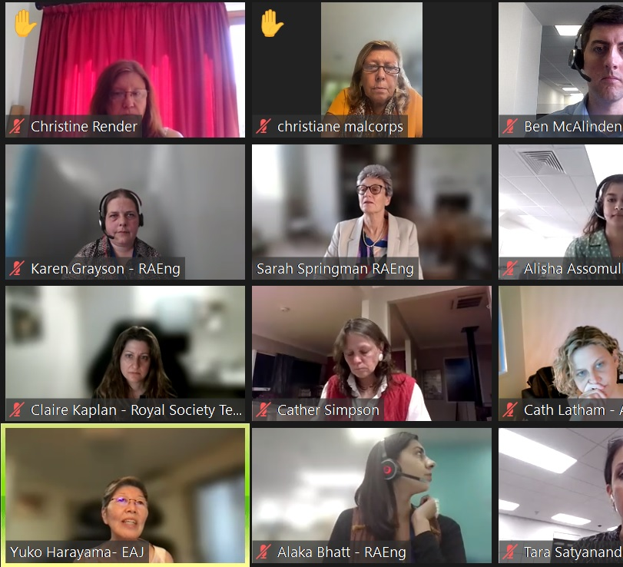
Overview
The Diversity and Inclusion (D&I) working group is Chaired by Professor Rachel Oliver FREng. Professor Oliver is also Chair of RAEng’s Diversity and Inclusion Committee, resulting in her having up to date insights into the opportunities and challenges surrounding D&I for engineering academies.
The group has slowly evolved into a community of practice, with Academy presentations becoming more common over the past year.
Meeting topics are determined by survey data, and feedback from members.

Slide 4
Overview – members
Academia Nacional de Ingenieria, Argentina
Academy of Engineering of Poland, Poland
Australian Academy of Technology and Engineering, Australia
Chinese Academy of Engineering, China
Danish Academy of Technical Sciences, Denmark
Engineering Academy of Japan, Japan
Indian National Academy of Engineering, India
Irish Academy of Engineering, Ireland
National Academy of Technologies of France, France
Netherlands Academy of Engineering, Netherlands
Nigerian Academy of Engineering, Nigeria
Royal Academy of Engineering, UK
Royal Society Te Aparangi, New Zealand
Royal Swedish Academy of Engineering Sciences, Sweden
Singapore Academy of Engineering, Singapore
South African Academy of Engineering, South Africa

Slide 5

Purpose
      Forum for academies to exchange on D&I issues they are facing, share best practice in embedding D&I and explore the role of CAETS in improving D&I in engineering.

Slide 6
Recap and progress
Recent working group meetings:
April – Global shift in diversity and inclusion:
Professor Sushmita Mitra from the Indian National Academy of Engineering (INAE) presented on INAE initiatives in the Fellowship and young association selection process.
Members discussed the global shift in D&I and how it has impacted their academies.
July – D&I initiatives:
Professor Yoko Nameki, Chair of the Gender Committee of the Engineering Academy of Japan (EAJ) presented on EAJ initiatives surrounding D&I.
Members split into breakout rooms and discussed initiatives taking place in their own academies.
September – Celebrating diversity in Australasia:
Inclusive events toolkit launches
Professor Chamindie Punyadeera (ATSE) presented on Aboriginal and Torres Strait Islander representation and reconciliation actions at CAETS
Professor Anthony Hōete FRSNZ presented on demonstrating D&I within the RSNZ.

Slide 7

Launch of the inclusive events toolkit
This toolkit was created to enable other academies to consider questions surrounding inclusivity when hosting events, without having to spend hours researching.
Our previous working group session at the CAETS Conference in Finland asked for feedback on a draft. The working group came up with a definition and the structure, and key elements that should be included.

Slide 8
Future directions
Raising the profile of the D&I working group within CAETS
Ensuring new fellows are aware of the working group / improving the public relations
Increasing CAETS academy membership, engagement, and participation with this working group
Exploring future topics and activities:
Positive feedback on the D&I toolkit and suggestion to produce further resources and evolve the D&I toolkit
Increasing diversity in Academy membership
Funding for D&I: A discussion on the skills and arguments to frame D&I needs to funders
Exploring challenges across the STEM pipeline
Advice and support for Academies facing D&I challenges

Slide 9
Next steps
Aiming to hold meetings four times a year – the next meeting before the close of 2025.
First ‘guide’ created: inclusive events toolkit launched in working group meeting today. Success will be accessed through feedback from members – the group plans to evolve this resource and create others.
D&I 2025 survey to come out later this year. Providing feedback on D&I focus areas for member academies
Next online meeting to focus on diversifying the Fellowship/Membership.
A plan to increase diversity of presentations inviting industry or academic experts to share their experiences in their countries.

Slide 10
Asks for the CAETS community:
Communications Committee to help promote the inclusive events toolkit with CAETS member academies.
Provide any feedback on the inclusive events toolkit to enable its evolution.
Engagement with the 2025-6 survey.
Promote and engage the D&I working group to your members.
We welcome suggestions for presentation and future topic ideas.
Listening, engaging, learning – has been a theme of this group!

Slide 11
Thank you

