Slide 1



CAETS Council Presentation
Brisbane, Australia, Sep 9, 2025
Axel Meisen, C.M., Ph.D., P.Eng., FCAE, FCIC
Co-chair, CAETS Energy Community
Canadian Academy of Engineering
axel@meisen.ca
CAETS ENERGY COMMUNITY REPORT 2025
TOWARDS LOW-GHG EMISSIONS FROM ENERGY USE IN SELECTED SECTORS: LOOKING BEYOND 2040
Overview
Purpose of the Project
Sectors & Working Groups
Project Methodology: Foresight
Key Strategies – Example: Forestry
Project Completion Schedule
Next Project (INAE Lead)
‘SEQUEL PROJECT’
Final Draft
September 2025

Slide 2
A. Purpose of the Project
To Answer the ‘Focal Question’
What actions need to be taken now, and in the near future, so that sufficient technologies are available and realistically deployable to ensure low-GHG emissions from energy use in selected sectors beyond the year 2040?

Slide 3
B. Industry Sectors & Working Groups
Forestry Industry
Tom Brown, Canada
Peter Axegård, Sweden
Ludo Diels, Belgium
Richard Kerekes, Canada
Esa Vakkilainen, Finland
Ian de la Roache, Canada
Agriculture & Food
Snow Barlow, Australia
Martin Fraguio, Argentina
Chris (Hyung-Sool) Lee, Korea
Oil & Gas Industry
Godwin Igwe, Nigeria/USA
José Luis Aburto, Mexico
Vaughan Beck, Australia
Manuel Bravo, Spain
Henrik Frandsen, Denmark
Erwin Fritz de la Orta, Mexico
Dirk Smit, Netherlands
Joe Zhou, Canada
Chemical Industry
Frank Behrendt, Germany
Oscar Vignart, Argentina
Tony Bi, Canada
Funmi Coker, Nigeria
Henrik Frandsen, Denmark
Rita Hofmann, Switzerland
Hyunjoo Lee, Korea
Chinho Park, Korea
Cement Industry
Rui Cai, China
Kim Kurtis, USA
Neven Duić, Croatia
Wang Lan, China
Ravindra Gettu, India
Paulo J.M. Monteiro, USA
R. Douglas Hooton, Canada
CCS
Vaughan Beck, Australia
Esa Vakkilainen, Finland
Iron & Steel Industry
Karl Buttiens, Belgium
IL Sohn, Korea
Eloy Álvarez, Spain
Mansheng CHU, China
Kejiang Li, China
Chinho Park, Korea
Martin Pei, Sweden
Yasuo Kishimoto, Japan
Takeo Hoshino, Japan
Louise Grondin, Canada
Buildings & Smart Cities
Tom Leahy, Ireland
Christy Adelowo, Nigeria
Yves Bamberger, France
Seung Lee, Korea
Vishaal Lutchman, South Africa
Rasmus Bramstoft, Denmark
Hydrogen
Henrik Frandsen, Denmark
Dirk Smit, Netherlands
ICT & Data Centres
Erol Gelenbe, UK
Yves Bamberger, France
Robert Crawhall, Canada
Tadeusz Czachorski, Poland
Franco Davoli, Italy
Michaela Meo, Italy
Albert Zomaya, Australia
Coupling
Rasmus Bramstoft, Denmark
Yves Bamberger, France
Pradeep Chaturvedi, India
Henrik Frandsen, Denmark
Franco Davoli, Italy
Tim Lieuwen, USA

Slide 4
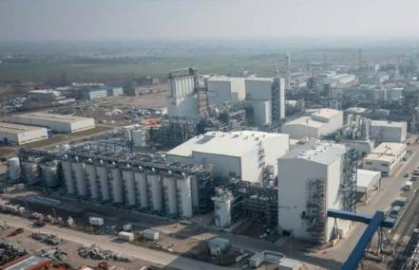
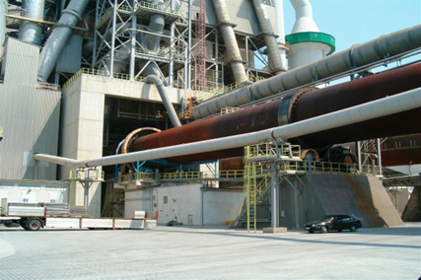
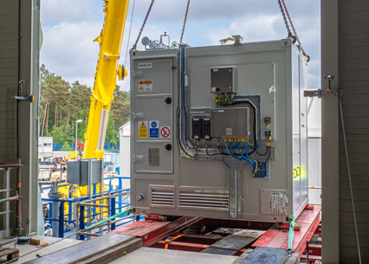

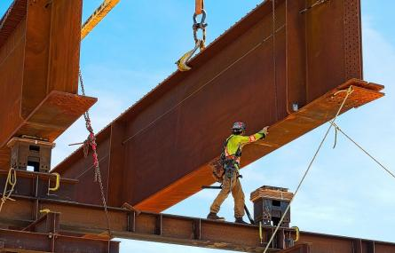
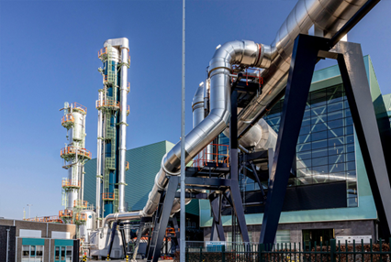
Report Structure
1 Executive Summary
2 Introduction
3 Forestry Industry
4 Agriculture & Food Industry
5 Oil & Gas Industry
7 Hydrogen
6 Carbon Capture & Storage
8 Chemical Industry
9 Cement Industry
10 Iron & Steel Industry
11 Buildings & Smart Cities
12 Coupling
13 Conclusions

Slide 5
C. Project Methodology: Foresight (Scenario Creation)
1. Define the ‘focal question’ and relevant timeframe
2. Review past events and current knowledge
Identify Drivers
Identify Critical Uncertainties
Develop Scenario Characteristics
Determine Implications & Strategies

Slide 6
Key Strategies: Example - Forestry Industry
Enhance Forest Value and Carbon Storage
Enhance forest productivity and minimize losses from fires, droughts, and pests
Increase carbon storage capacity through enhanced forest management
Improve and expand forest land for harvesting of wood and storing carbon
Develop Sustainable, Circular Products
Pursue innovative uses of lumber products, especially in building construction
Pioneer and commercialize new products based on wood constituents
Use sustainable energy across the full lifecycle of products
Maximize Use of Residuals
Extract value from all wood residuals, especially lignin
Minimize waste in all production, use, and end-of-life operations
Ensure Availability of Expert Personnel
Secure and retain outstanding leaders, experts, professors, and students

Slide 7
F. Project Completion Schedule
Task | End Date
Chapter adjustments based on external reviews | Sep 2025
Presentation in CAETS Brisbane meetings | Sep 2025
Review by CAETS Academies and endorsement | Nov 2025
Final editing | Dec 2025
Release of report | Jan 2026

Slide 8



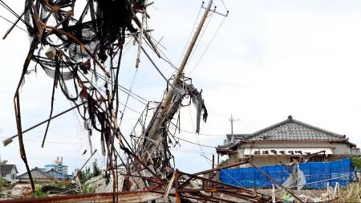





Next Project: Security of Energy Supply - Towards Reliable Low-carbon Energy for All
Security: Reliability, affordability, and sustainability under normal and abnormal conditions from all energy sources
Perspectives: citizens, companies, communities and cities, countries; local, regional, national, and international considerations and collaboration
Focus: Innovative engineering contributions to improving energy security for all, including residential and corporate users
Outcomes: Pathways and strategies for improving current and developing new technologies to achieve energy security; new ideas for citizens, businesses, investors, governments, regulators, and academics

Slide 9

Next Project: Security of Energy Supply - Towards Reliable Low-carbon Energy for All
Start date:
Q4 2025 or Q1 2026
Project Lead:
Indian National Academy
of Engineering (INAE)
Working Group Participants:
CAETS Members
plus other experts
CAETS ENERGY COMMUNITY

